Slide 1
AdaNet for Concrete Strength prediction

Slide 2
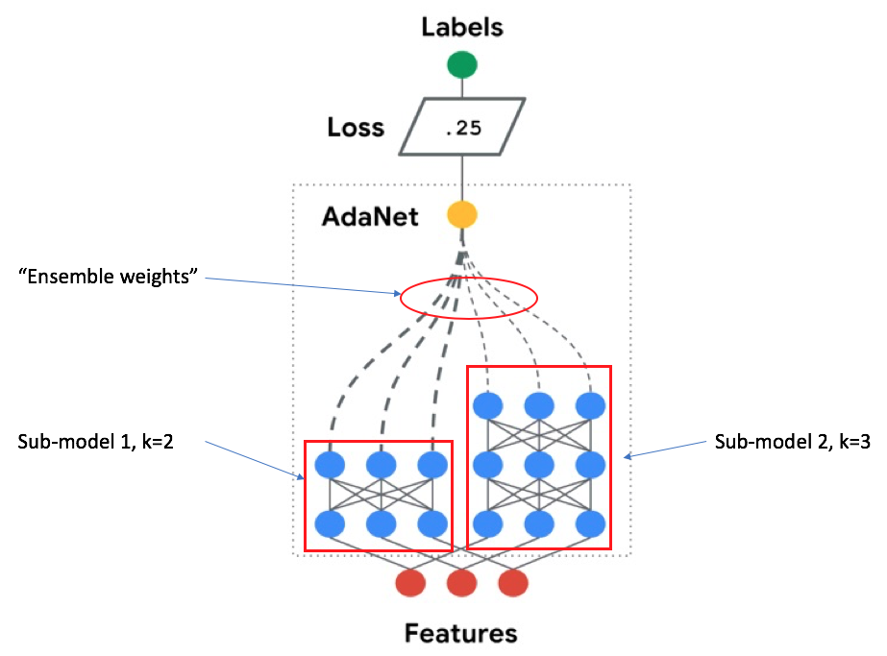
Adaptive Structural Learning (AdaNet)
Ensemble of several subnetworks
Include a candidate subnetwork only when it improves the ensemble’s training loss
https://ai.googleblog.com/2018/10/introducing-adanet-fast-and-flexible.html

Slide 3
AdaNet
Loss(MSE) | Subnetworks
0.03107 | 1 layer ANN | 1 layer ANN | 2 layer ANN
0.03096 | 1 layer ANN | 1 layer ANN | 2 layer ANN | 2 layer ANN
0.03107 | 1 layer ANN | 1 layer ANN | 2 layer ANN
0.03042 | 1 layer ANN | 1 layer ANN | 1 layer ANN | 1 layer ANN | 1 layer ANN
0.03098 | 1 layer ANN | 1 layer ANN | 2 layer ANN | 3 layer ANN

